Slide 1

Diagnosis ML
Chris Burley, Brandon Lee, Vik Shah, Navid Motlagh, Tu Cam Dang

Slide 2
Agenda
Project Background & Objective – Tu Cam
Project Scoping – Navid
Extract Transform Load & Cleaning Data – Vik
Machine Learning Modelling – Chris
Machine Learning Predictions – Brandon

Slide 3
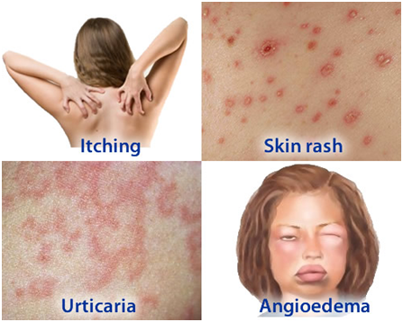
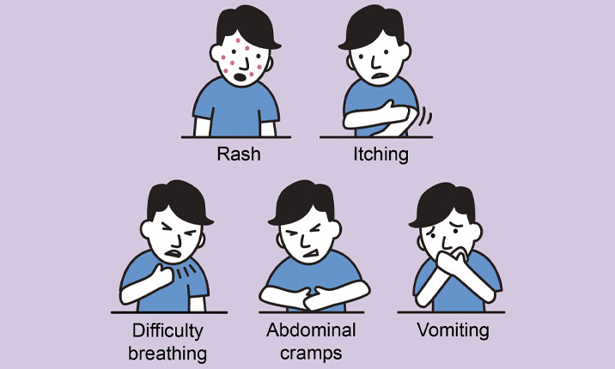
What would you do if you have skin or body reaction? - Search symptom via Internet - See GP/ emergency - Leave it - Taking painkiller - Ask family/ friend who works in the health industry.
Notes:
When you have one of this symptoms etc. rash, itching, vomiting? What would you do?
- search symptom - See GP/ emergency - Leave it - Taking painkiller - Ask friend who work in health industry. For me, if it’s not serious, I would like to check it on internet. If it’s serious I would see GP immediately.

Slide 4

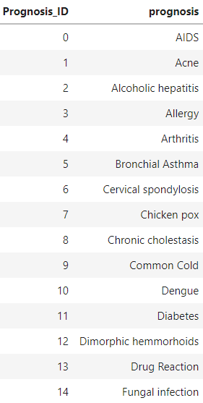
Background
Background: 21st Century human nature is to google everything. As a result, self-prognosis is more common. The market has created itself and this tool will meet demand needs.
Objective: machine learning to predict a patient’s ailment based on 132 symptoms i.e., variables.

Slide 5

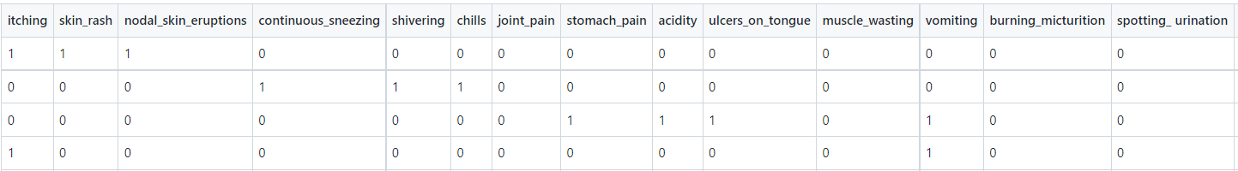
Scoping
Identified sample dataset from Kaggle, listing 132 symptoms with 42 unique prognoses
Dataset illustrates symptoms in binary form i.e., 1 = yes and 0 = no
Prior medical knowledge is recommended to ensure appropriate interpretation of the symptoms
Future scoping may include more comprehensive details and descriptions for each symptoms e.g., using tooltips
Test and Train Data was stored in AWS and fed into Jupyter Notebook for training and testing
Test dataset (42 records) & Train dataset (4920 records) were used
Binary form

Slide 6
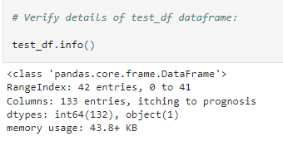
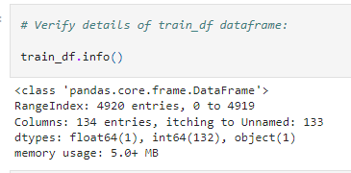
Scoping
Test dataset records
Train dataset records
Number of columns (Symptoms)

Slide 7

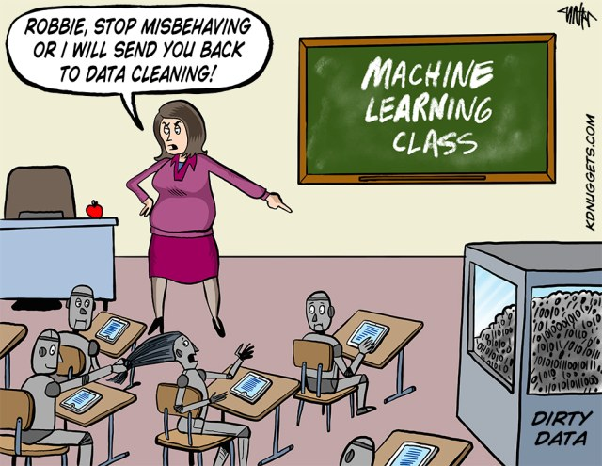
Extract Transform Load

Slide 8
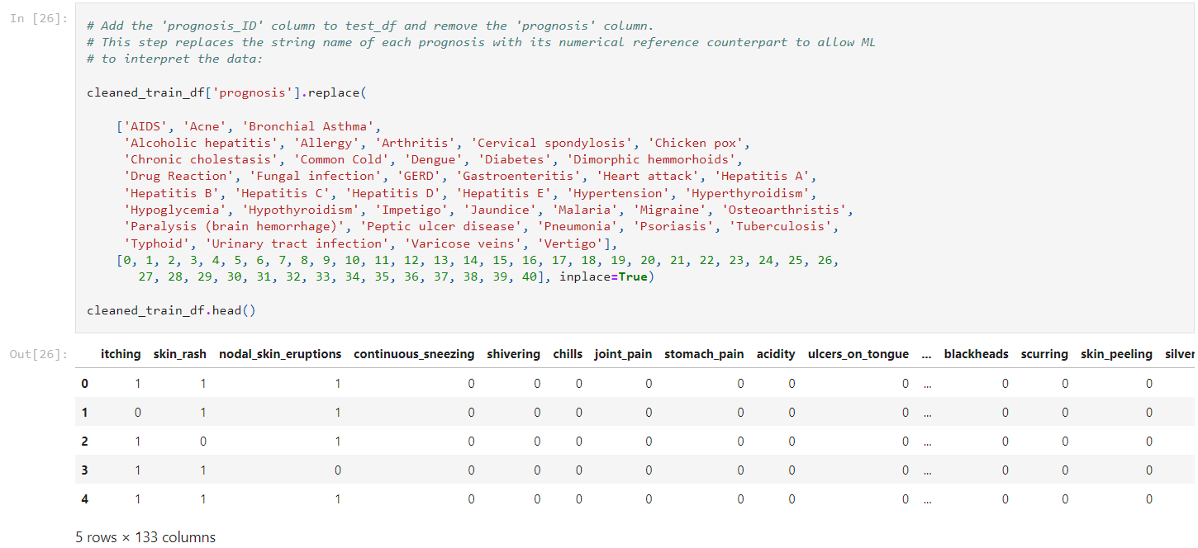
Extract Transform Load
Extract from kaggle,
Import csv
Transform dataset,
Delete blank column
Rename columns to simply and normalize
Replace similar data to uniform
Delete null rows
Load dataframe,
Cleaned_train_df

Slide 9

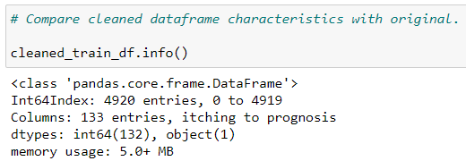
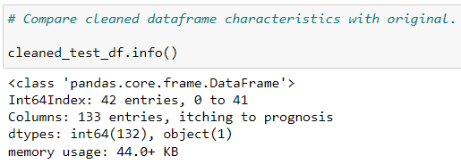
Modelling
As previously mentioned, our data from Kaggle.com was split as follows:
Training Data (4920 rows)
Testing Data (42 rows)
Columns
Rows
Columns
Rows

Slide 10
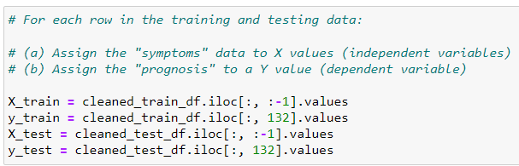
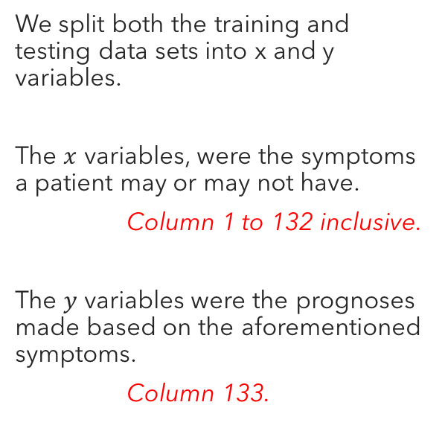
Modelling
We split both the training and testing data sets into x and y variables.
The $x$ variables, were the symptoms a patient may or may not have.
Column 1 to 132 inclusive.
The $y$ variables were the prognoses made based on the aforementioned symptoms.
Column 133.

Slide 11
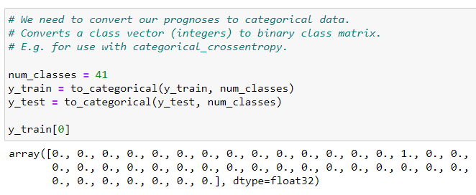
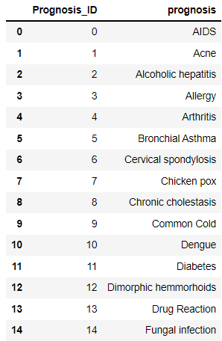
Modelling
Our prognoses were then converted to categorical data as follows:
Note that a 1 in the 15th position of the array represents a diagnosis of ‘Fungal Infection’ according to the key created earlier:

Slide 12
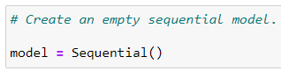
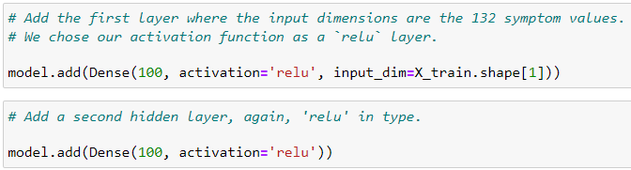
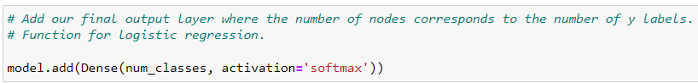
Modelling
At this point, a model could be built.
(1) Create an empty model
(3) Add an output layer
(2) Add two hidden layers to the ML model.

Slide 13
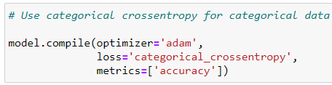
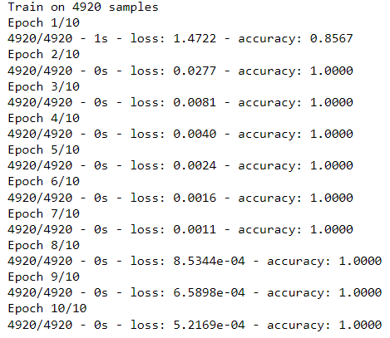
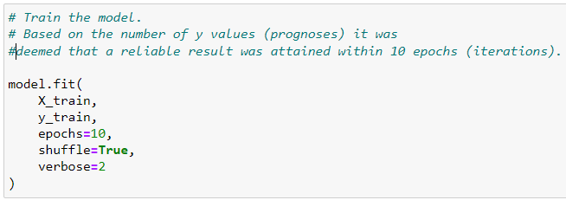
Modelling
You can see that by the second complete pass of the training data through the model the ratio of correct predictions to the total number of rows was 1:1.
We then compiled the model before training it.

Slide 14
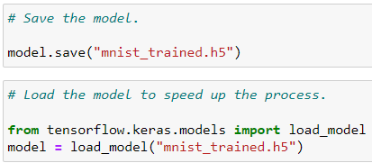
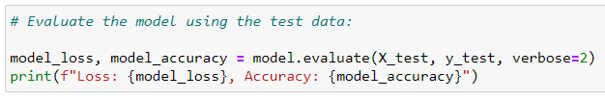
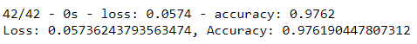
Modelling
We then saved the model.
Lastly, we tested the model, using the test data, and determined the model’s overall accuracy.
Our model returned an overall accuracy rating of nearly 98%, which means that it will deliver the correct diagnosis almost every single time, given accurate symptom information.

Slide 15

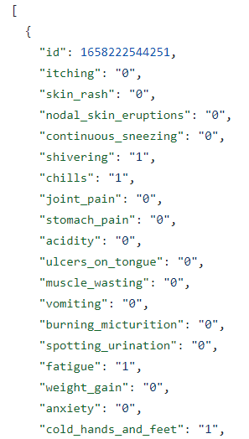
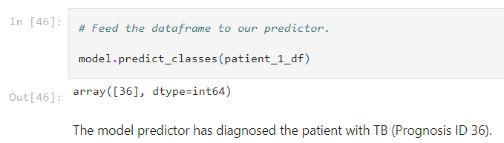
Predictions
Patient/ Doctor inputs symptoms in form and ML predicts prognosis

Slide 16

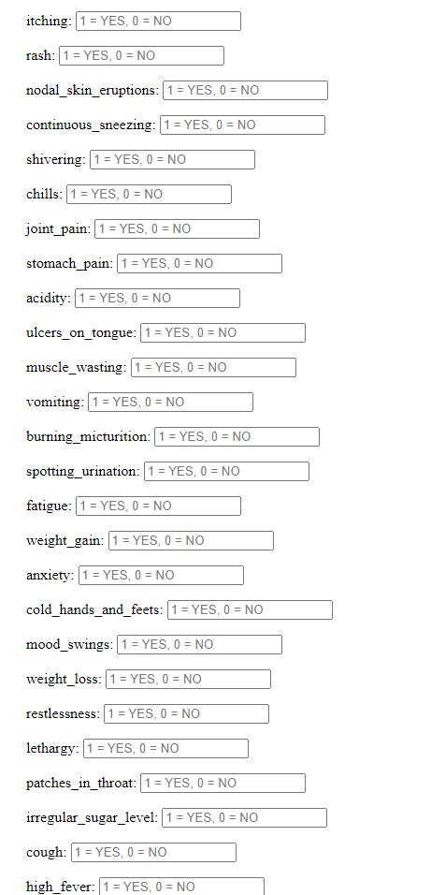
Prediction
Doctor/patient completes an online questionnaire of 132 symptoms.
When submitted, the information is converted into a JSON format.

Slide 17

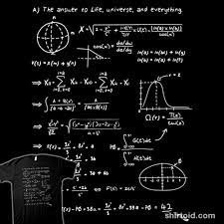


Prediction
The JSON data is fed into MongoDB
From MongoDB, the data is converted into a CSV file
The CSV file is then fed into the ML for prediction

Slide 18

Prediction
Demonstration

Slide 19
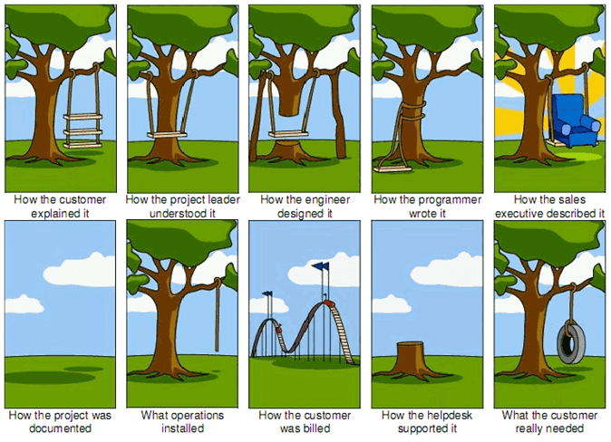
Questions

